Slide 1
SC2001 ‘Project 2’ {
title.py
contents.java
[The Dijkstra’s Algorithm]
< Group Members: Chelyn (U2523007F),
Ryan (U2522244E), Kyaw Lin (U2520058L) >
}
SC2001 Project 2

Slide 2
Table Of ‘Contents’ {
01
02
03
title.py
contents.java
Adjacency Matrix
< Using array for priority queue and time complexity analysis >
Adjacency List
< Using minimizing heap for priority queue and time complexity analysis >
Comparison
< Comparing the 2 methods >
}
SC2001 Project 2

Slide 3
01 {
[Adjacency Matrix]
title.py
contents.java
< Using array for priority queue and time complexity analysis >
}
SC2001 Project 2

Slide 4
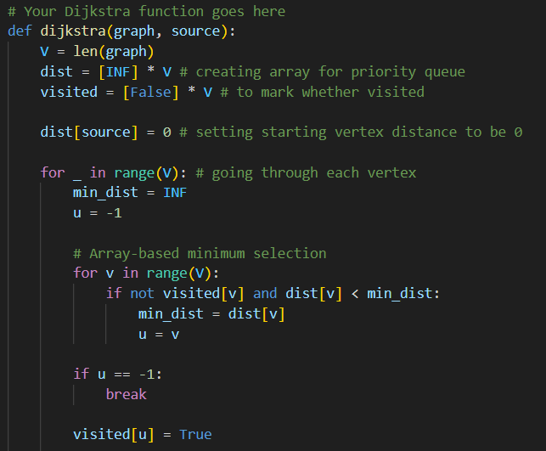
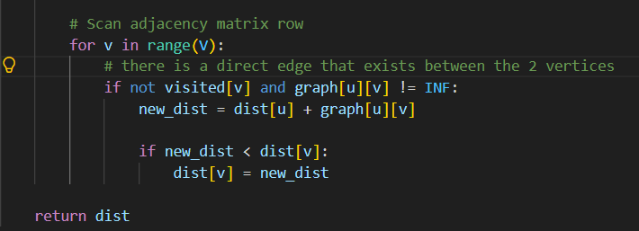
dijkstra() {
title.py
functions.py
}
SC2001 Project 2

Slide 5
Theoretical Time Analysis {
title.py
contents.java
Operation | Frequency | Time Complexity
Initialise distance and visited arrays | Once | O(V)
Find minimum-distance unvisited vertex | Up to V iterations, scanning V vertices each | O(V²)
Check adjacent vertices and relax edges | Up to V iterations, scanning V matrix entries each | O(V²)
}
SC2001 Project 2
Notes:
For Part (a), we implemented Dijkstra's algorithm using an adjacency matrix and an array-based priority queue. Finding the minimum-distance unvisited vertex requires scanning up to V vertices, repeated up to V times, giving O(V²). Similarly, relaxing edges requires scanning an entire row of the adjacency matrix for each selected vertex, giving another O(V²). Therefore, the overall time complexity is O(V²). We expect runtime to grow quadratically as V increases, while varying E with V fixed should have a smaller effect.

Slide 6
Theoretical Time Analysis {
< Overall Time Complexity>
title.py
contents.java
T(V,E) = O(V) + O(V²) + O(V²)
= O(V²)
}
SC2001 Project 2
Notes:
For Part (a), we implemented Dijkstra's algorithm using an adjacency matrix and an array-based priority queue. Finding the minimum-distance unvisited vertex requires scanning up to V vertices, repeated up to V times, giving O(V²). Similarly, relaxing edges requires scanning an entire row of the adjacency matrix for each selected vertex, giving another O(V²). Therefore, the overall time complexity is O(V²). We expect runtime to grow quadratically as V increases, while varying E with V fixed should have a smaller effect.

Slide 7
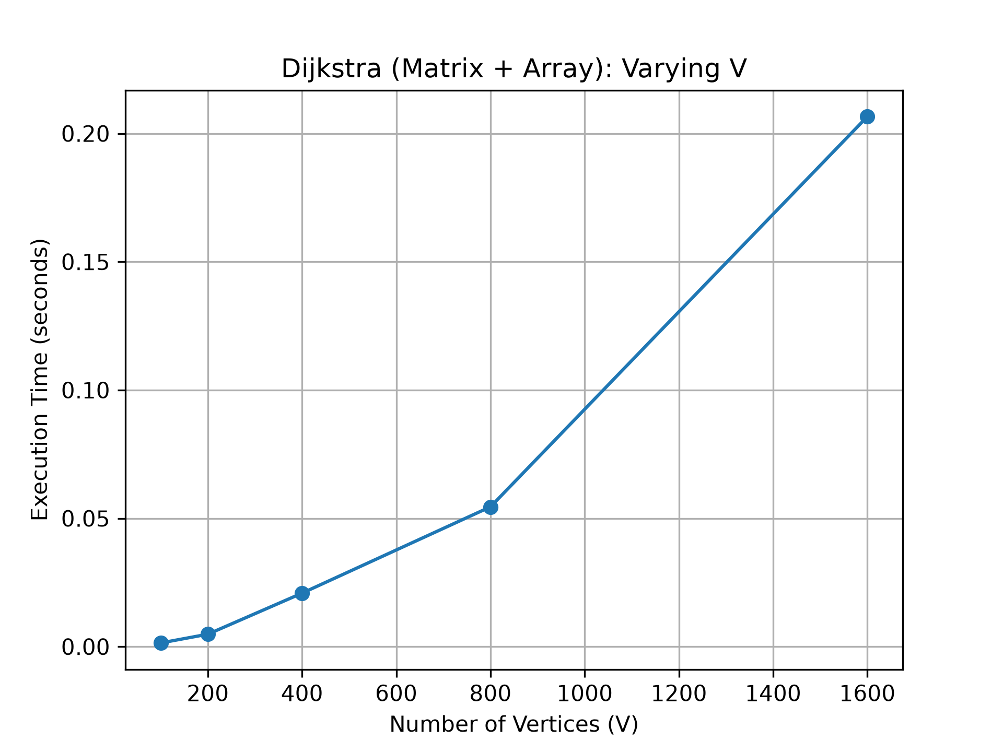
title.py
experiment.py
Varying V (E = 2V) {
V | Time (s)
100 | 0.001430
200 | 0.004838
400 | 0.020834
800 | 0.054488
1,600 | 0.206589
Larger V significantly increases the amount of time needed to execute
}
SC2001 Project 2

Slide 8
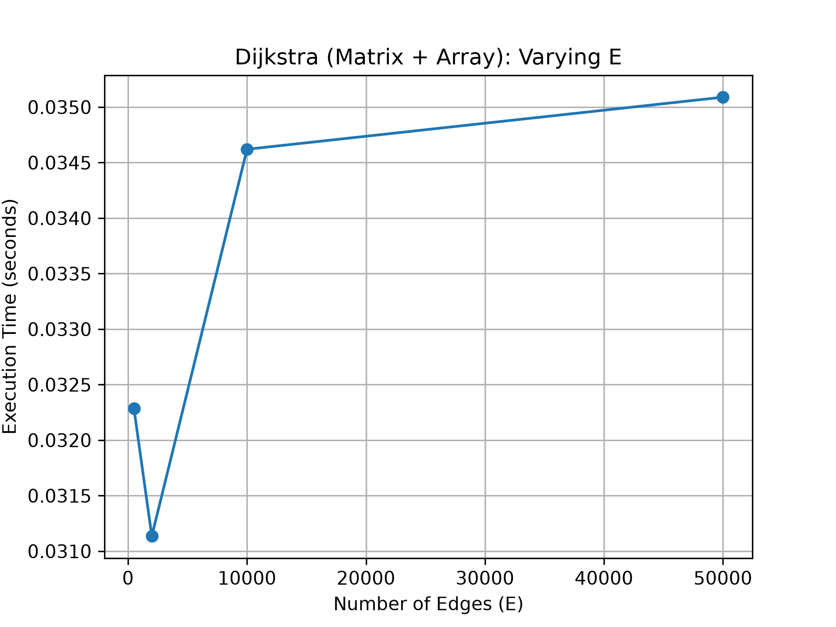
title.py
experiment.py
Fixed V = 500 (Varying E) {
E | Time (s)
500 | 0.032285
2,000 | 0.031136
10,000 | 0.034620
50,000 | 0.035089
All timings are close - density of graph does not really affect time for execution
}
SC2001 Project 2

Slide 9
02 {
[Adjacency List]
title.py
contents.java
< Dijkstra with a minimizing heap >
Implementation and time complexity analysis
}
SC2001 Project 2

Slide 10
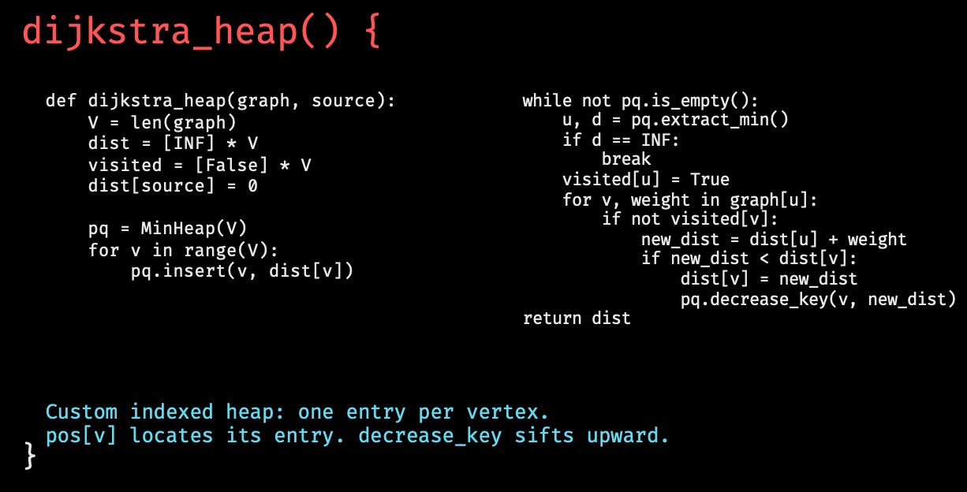
title.py
contents.java
SC2001 Project 2
Notes:
Size for each insertion sort algorithm needs to be bigger than 1 ands smaller than n for the splits
Insertion sort + mergesort based on value on S

Slide 11
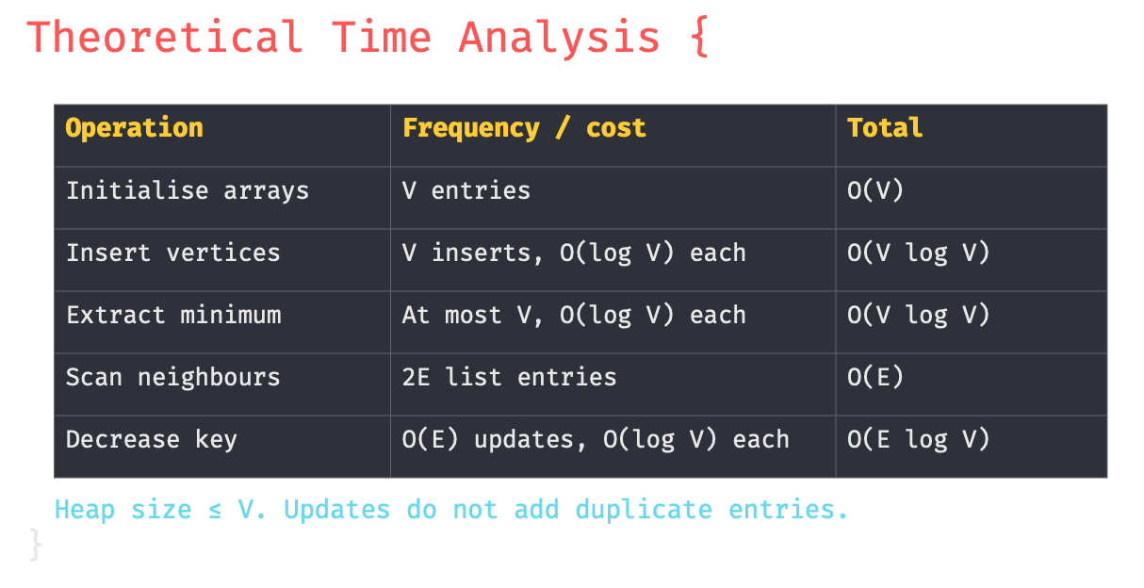
title.py
contents.java
SC2001 Project 2
Notes:
Size for each insertion sort algorithm needs to be bigger than 1 ands smaller than n for the splits
Insertion sort + mergesort based on value on S

Slide 12
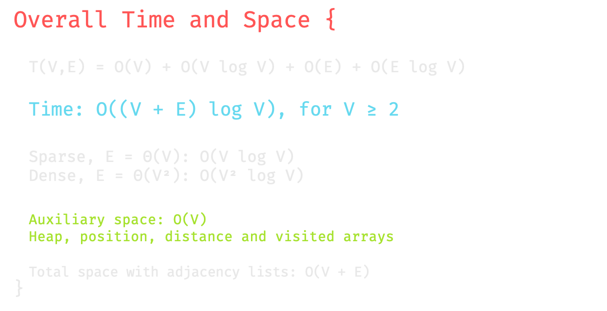
title.py
contents.java
SC2001 Project 2
Notes:
Size for each insertion sort algorithm needs to be bigger than 1 ands smaller than n for the splits
Insertion sort + mergesort based on value on S

Slide 13
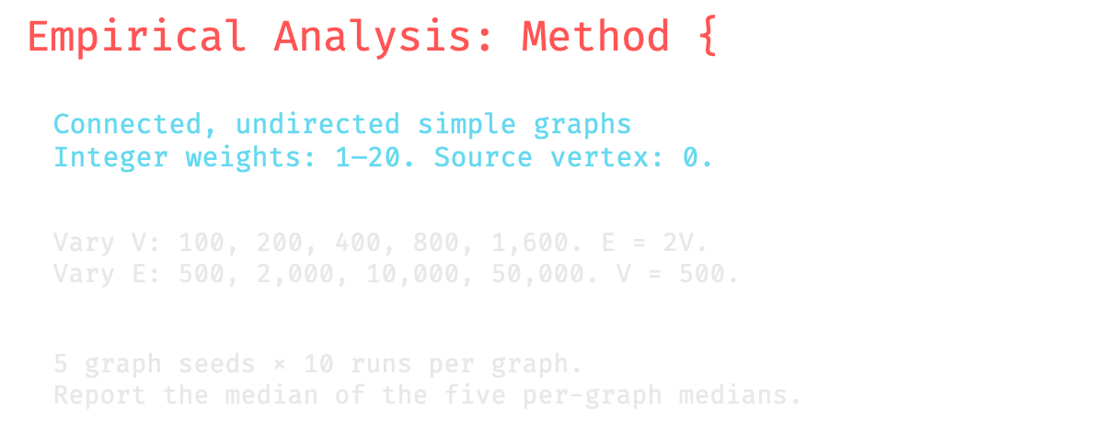
title.py
contents.java
SC2001 Project 2
Notes:
Size for each insertion sort algorithm needs to be bigger than 1 ands smaller than n for the splits
Insertion sort + mergesort based on value on S

Slide 14
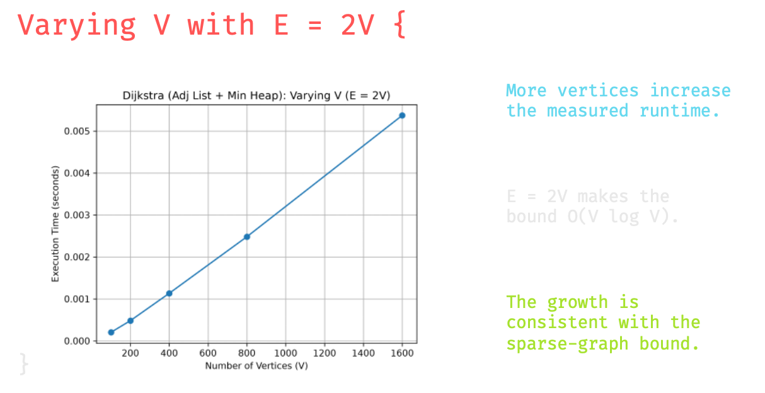
title.py
contents.java
SC2001 Project 2
Notes:
Size for each insertion sort algorithm needs to be bigger than 1 ands smaller than n for the splits
Insertion sort + mergesort based on value on S

Slide 15
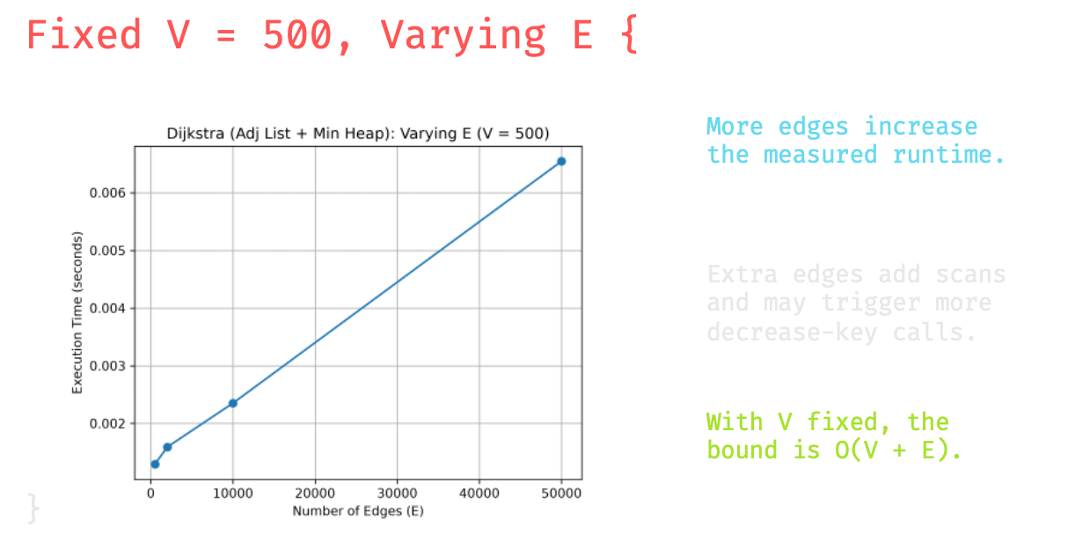
title.py
contents.java
SC2001 Project 2
Notes:
Size for each insertion sort algorithm needs to be bigger than 1 ands smaller than n for the splits
Insertion sort + mergesort based on value on S

Slide 16
03 {
[Comparison]
title.py
contents.java
< Comparing the 2 methods >
}
SC2001 Project 2

Slide 17
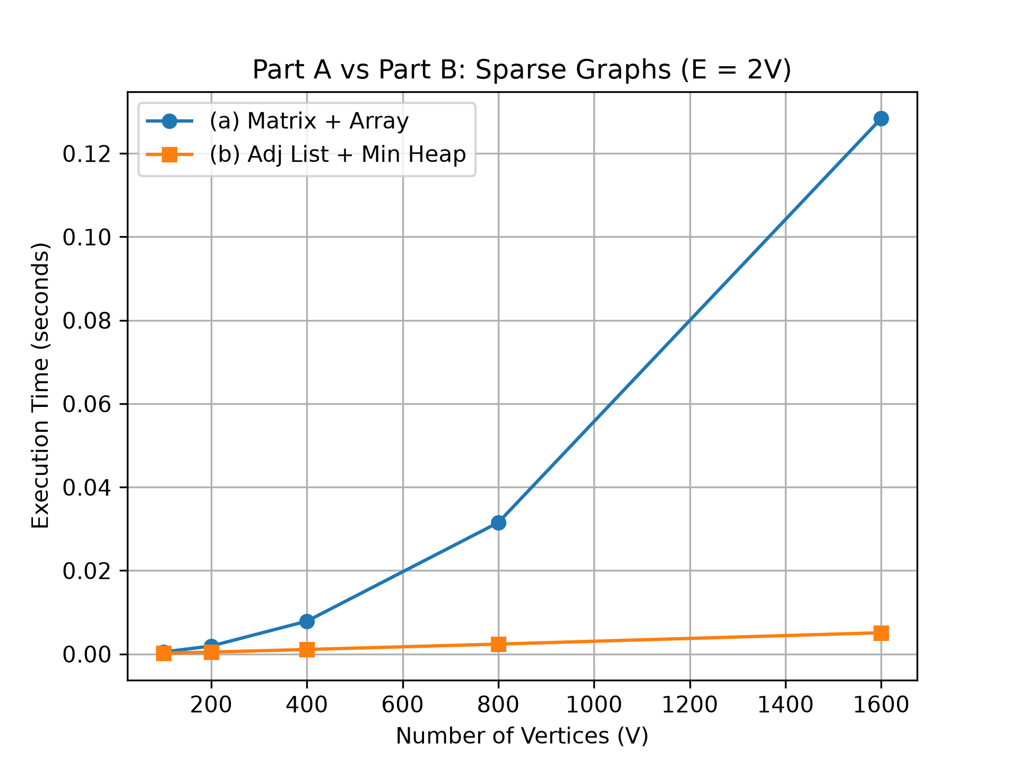
title.py
compare_ab.py
Sparse Graphs (E = 2V) {
V | E | Part A (ms) | Part B (ms)
100 | 200 | 0.483 | 0.194
200 | 400 | 1.918 | 0.470
400 | 800 | 7.879 | 1.090
800 | 1600 | 31.521 | 2.384
1600 | 3200 | 128.397 | 5.108
}
SC2001 Project 2

Slide 18
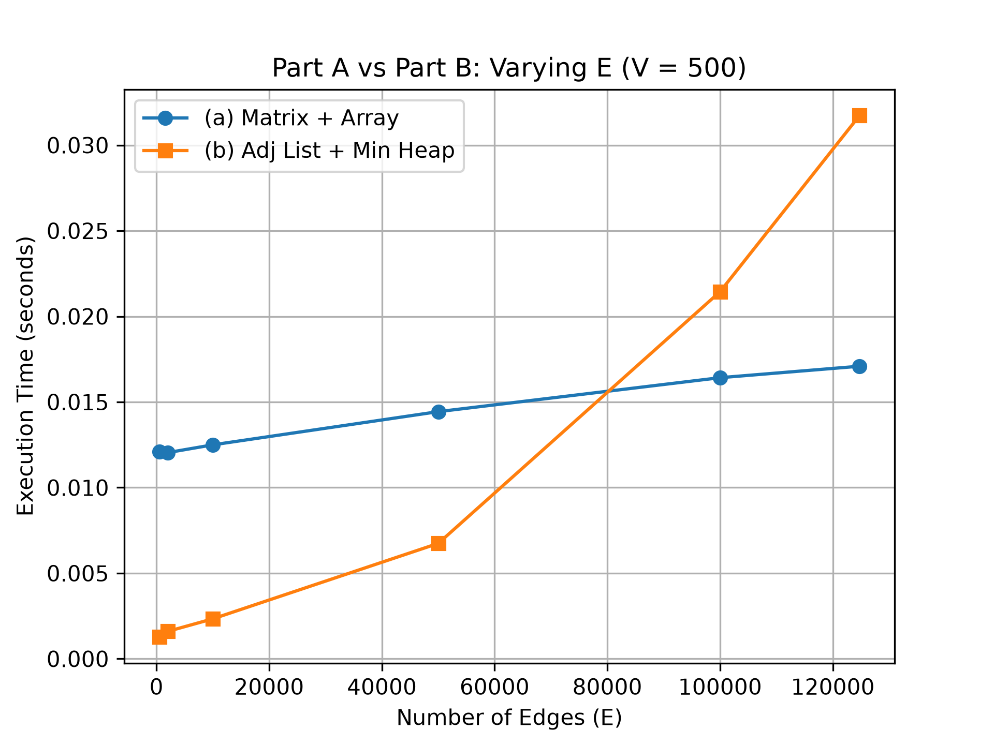
title.py
compare_ab.py
Density Grows (V = 500){
V | E | Part A (ms) | Part B (ms)
500 | 500 | 12.097 | 1.276
500 | 2000 | 12.043 | 1.602
500 | 10000 | 12.497 | 2.335
500 | 50000 | 14.435 | 6.741
500 | 100000 | 16.419 | 21.443
500 | 124750 | 17.088 | 31.733
}
SC2001 Project 2

Slide 19
Conclusion {
title.py
contents.java
 | (a) Matrix + Array | (b) List + Heap
Time | O(V²) | O((V+E) log V)
Memory | O(V²) | O(V + E)
Best for | Dense graphs | Sparse graphs
}
SC2001 Project 2

Slide 20
Thanks; {
title.py
contents.java
‘Do you have any questions?’
Q & A
}
SC2001 Project 2

